Slide 1
Managing Systems Project
Chapter 3

Slide 2
What Shapes a Project?
What Shapes a Project?
Successful projects must be completed on time, within budget, meet requirements, and satisfy users
What Is a Project Triangle
Cost, scope, time
Usually one of these is fixed
A budget cast in stone
An inflexible scope
A schedule fixed by factors beyond the firm’s control

Slide 3
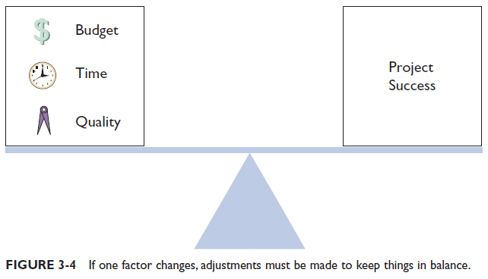
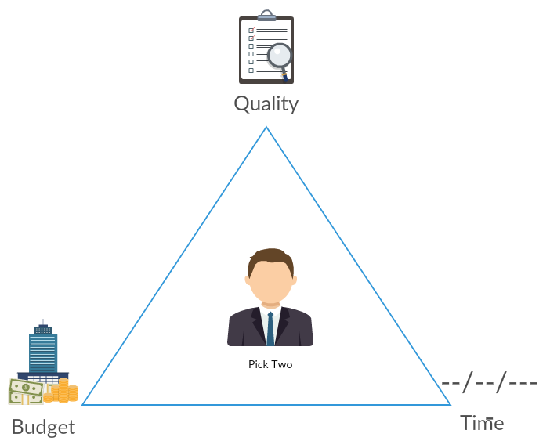

Slide 4
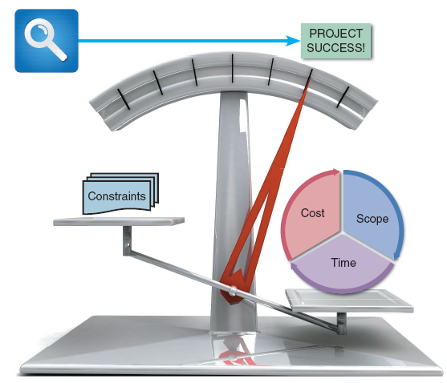
Overview of Project Management(Cont.)
What Does a Project Manager Do?
Good leadership is essential
Project planning
Identify all project tasks and estimate the completion time and cost of each
Project scheduling
Create a specific timetable that shows tasks, task dependencies, and critical tasks that might delay the project
FIGURE 3-3 A successful project must balance cost, scope, and time against a set of constraints. In this example, the project appears to be a success

Slide 5
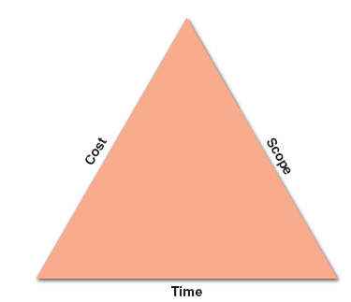
Overview of Project Management(Cont.)
What Does a Project Manager Do? (Cont.)
Project monitoring
Guiding, supervising, and coordinating the project team’s workload
Project reporting
Create regular progress reports to management, users, and the project team itself
FIGURE 3-5 A typical project triangle includes
cost, scope, and time

Slide 6
Step 1: Create a Work Breakdown Structures
A work breakdown structure (WBS) involves breaking a project down into a series of smaller tasks.
Before creating work breakdown structures, you should understand the two primary chart types: Gantt charts and PERT/CPM charts.

Slide 7
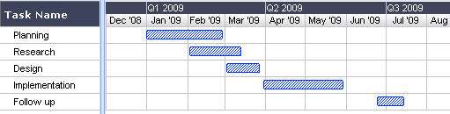
What is a Gantt chart?
A Gantt chart, commonly used in project management, is one of the most popular and useful ways of showing activities (tasks or events) displayed against time.
On the left of the chart is a list of the activities and along the top is a suitable time scale. Each activity is represented by a bar; the position and length of the bar reflects the start date, duration and end date of the activity.

Slide 8
This allows you to see at a glance:
What the various activities are
When each activity begins and ends
How long each activity is scheduled to last
Where activities overlap with other activities, and by how much
The start and end date of the whole project

Slide 9
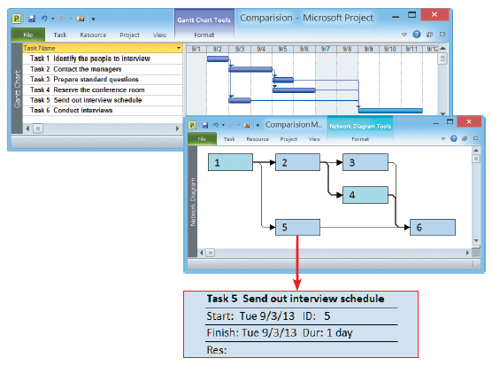
PERT
A PERT chart is a project management tool used to schedule, organize, and coordinate tasks within a project. PERT stands for Program Evaluation Review Technique.
A PERT chart presents a graphic illustration of a project as a network diagram consisting of numbered nodes (either circles or rectangles) representing events, or milestones in the project linked by labelled vectors (directional lines) representing tasks in the project.
FIGURE 3-7 The top screen shows a Gantt chart with six tasks. The PERT
chart in the bottom screen displays an easy-to-follow task pattern for the same project. When the user mouses over the summary box for Task 5, the details become visible

Slide 10
Which is better: Gantt vs. PERT
Gantt offers a valuable snapshot view of the project
PERT is more useful for scheduling, monitoring, and controlling the actual work
PERT displays complex task patterns and relationships
PERT chart boxes can provide more detailed information

Slide 11
A: Identifying Tasks in a Work Breakdown Structure (WBS)
WBS must clearly identify each task and include an estimated duration
A task, or activity, is any work that has a beginning and an end and requires the use of company resources such as people, time, or money
Tasks are basic units of work that the project manager plans, schedules, and monitors — so they should be relatively small and manageable

Slide 12
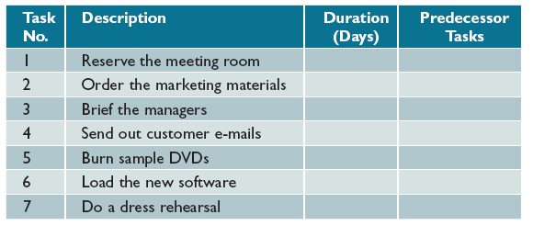
B: Listing the Tasks
List all tasks
Put tasks in order
Add a description
Decide how long each task takes
Decide which tasks must go first
FIGURE 3-10 In this table, columns have been added for task number, description, duration, and predecessor tasks, which must be completed before another task can start

Slide 13
C: Estimating Task Duration
Tasks can be hours, days, or weeks
If tasks uses days, the units of measurement are called person-days
A person-day represents the work that one person can complete in one day

Slide 14
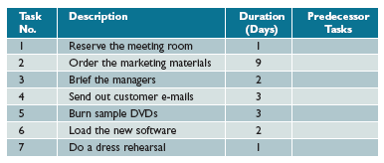
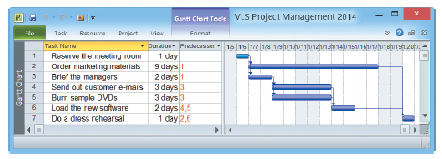
D: Create Gantt Chart
FIGURE 3-11 Task durations have been added, and the WBS is complete except for
predecessor task information. The predecessor tasks will determine task patterns and
sequence of performance
body
https://ganttpro.com/
FIGURE 3-12 This Microsoft Project screen displays the same WBS, including task number, task name,
duration, and predecessor tasks

Slide 15
Step 2: Identify Task Patterns
What Are Task Patterns
Tasks depend on each other and must be performed in a sequence
Involve dependent tasks, multiple successor tasks, and multiple predecessor tasks
How Do I Use Task Boxes to Create a Model?
Each section of the task box contains important information about the task, including the task name, task ID, task duration, start day/date, and finish day/date

Slide 16

Task Name
Should be brief and descriptive
Task ID
Can be a number or code that provides unique identification
Task Duration
Amount of time it will take to complete a task
Start Day / Date
The start day/date is the time that a task is scheduled to begin
Finish Day / Date
The finish day/date is the time that a task is scheduled to be completed
FIGURE 3-13 Each section of the task
box contains important information about the task, including the Task Name, Task ID, Task Duration, Start Day/Date, and Finish Day/Date

Slide 17
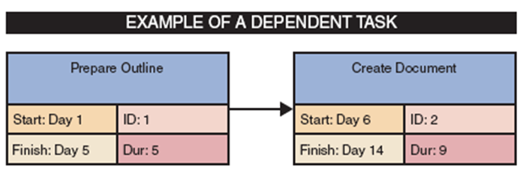
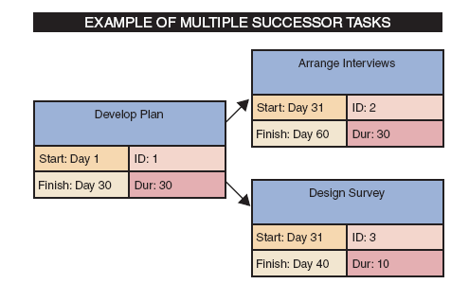
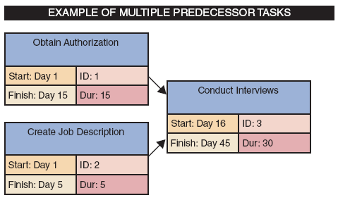
What Are the Main Types of Task Patterns?
Task Patterns Type
Dependent Task When tasks must be completed one after another Called dependent tasks because one depends on the other
Multiple Successor When several tasks can start at the same time, Each is called a concurrent task
Multiple Predecessor When a task requires two or more prior tasks to be completed before it can start

Slide 18
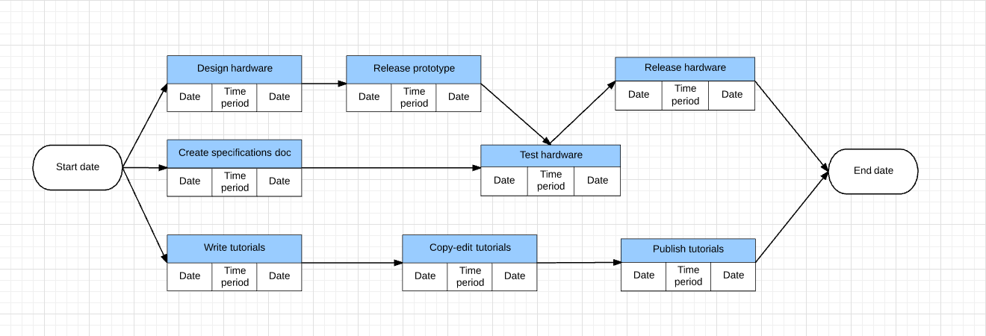
A: create your PERT Chart

Slide 19
Step 3: Calculate the Critical Path
What is a Critical Path?
A series of tasks which, if delayed, would affect the completion date of the overall project
If any task on the critical path falls behind schedule, the entire project will be delayed

Slide 20
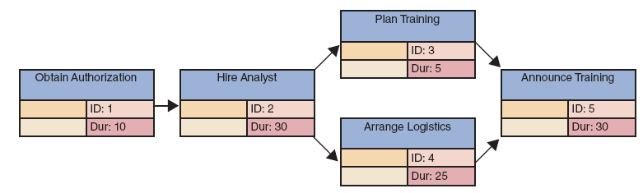
How Do I Calculate the Critical Path?
Review patterns, determine start and finish dates, which will determine the critical path
FIGURE 3-21 Example of a PERT/CPM chart with five tasks. Task 2 is a dependent task that has multiple successor tasks. Task 5 has multiple predecessor tasks. In this figure, the analyst has arranged the tasks and entered task names, IDs, and durations

Slide 21
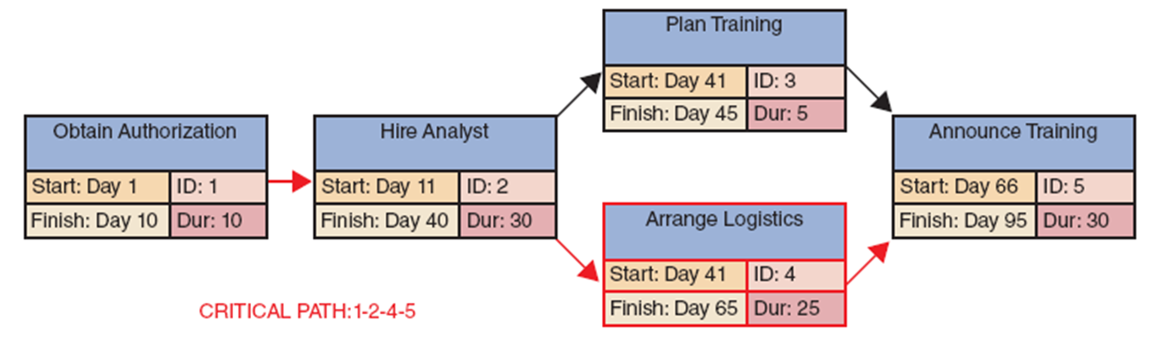
FIGURE 3-22 Now the analyst has entered the start and finish times, using the rules explained in this section. Notice that the overall project has a duration of 95 days

Slide 22
Chapter 3 Assignment
The IT group at Game Technology has received approval to add a new entry-level systems analyst position. You will help set up the hiring timetable and tasks. After speaking to several people in the department, you identified seven tasks and the order in which they should be performed. Using your notes, you write up the following statement: First, review the applications (2days). Then start three tasks: notify the IT team (2 days), reserve a conference room (1 day), and set up an interview schedule (5 days). When the team has been notified and the conference room reserved, prepare a set of interview questions (2 days). When the questions are ready and the interview schedule has been developed, conduct the interviews (5 days). After the interviews are done, meet with the hiring committee to select a candidate (1 day).
Practice Tasks
A. Prepare a work breakdown structure showing tasks, durations, and predecessor tasks.
B. Calculate the start and finish date for each task, and determine the critical path.

